Slide 1
Mid Term Project
Advances in Data Sciences Prudential Life Insurance RISK Assessment
Bhanuja Nagore

Slide 2

Table of Contents:
Problem Statement
Approach and Method Used
Data Pre-processing and Cleaning
Data Visualization
Multiple Linear Regression
SVM Regression
Decision Tree Regression
Data Story

Slide 3

Problem Statement & Approach
Data Discovery and Data Cleaning –(Plotting various graphs, bar chart, Histograms to analyze data)
Model Building – (Linear Regression, Decision Tree and SVM)
Model Planning (Hypothesis Testing – One Way ANOVA and Confusion Matrix)
Communicate results - Tableau
A predictive model that accurately classifies risk using a more automated approach, can greatly impact public perception of the industry

Slide 4
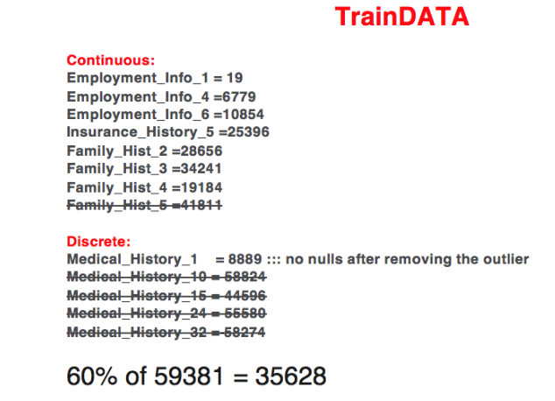
Data Pre-processing and Cleaning
Plotted graphs, charts and Histogram to analyze the data
Dataset has 127 independent variables and 1 dependent variables with over 58000 records
These 128 features are either continuous, discrete or categorical in nature
Such values were replaced by the mean of values
Mean was used instead of max, min or frequent value for this purpose so that the distribution of the values is not disturbed
Categorical columns like Product_Info_3, Medical_History_2, Employment_Info_2 had more than six categories which led to elimination from the dataset
Categorical columns with two values (ex. 1, 2) were converted to Binary (0, 1)
More than 2 values were split into different columns using 0 to C transformation

Slide 5
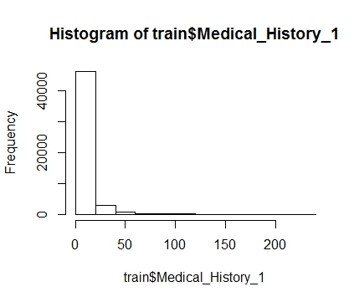
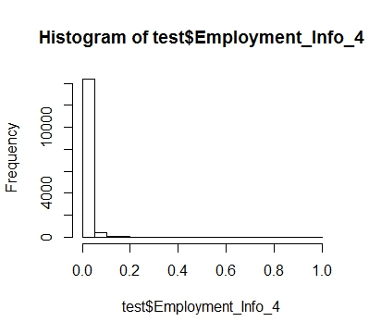
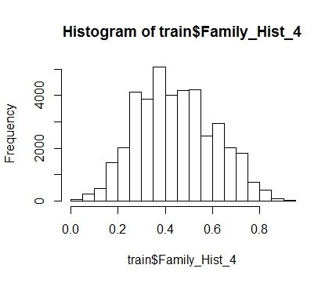
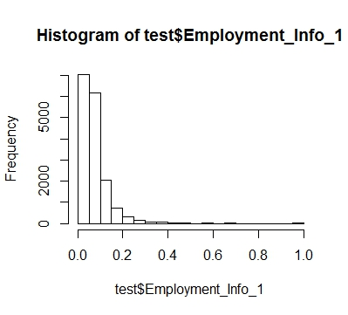
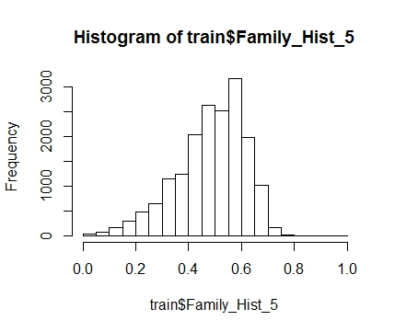
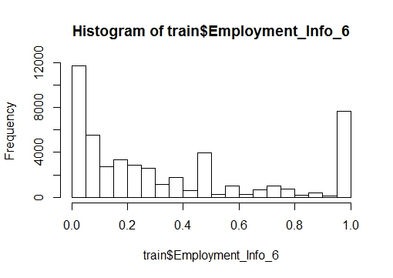
Analysis – Data

Slide 6
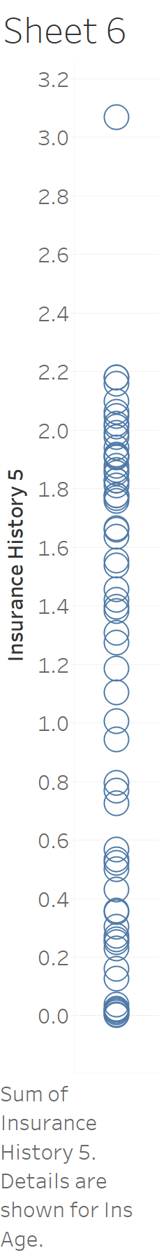
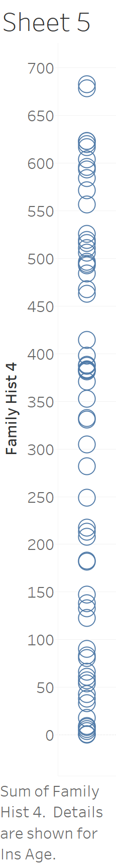
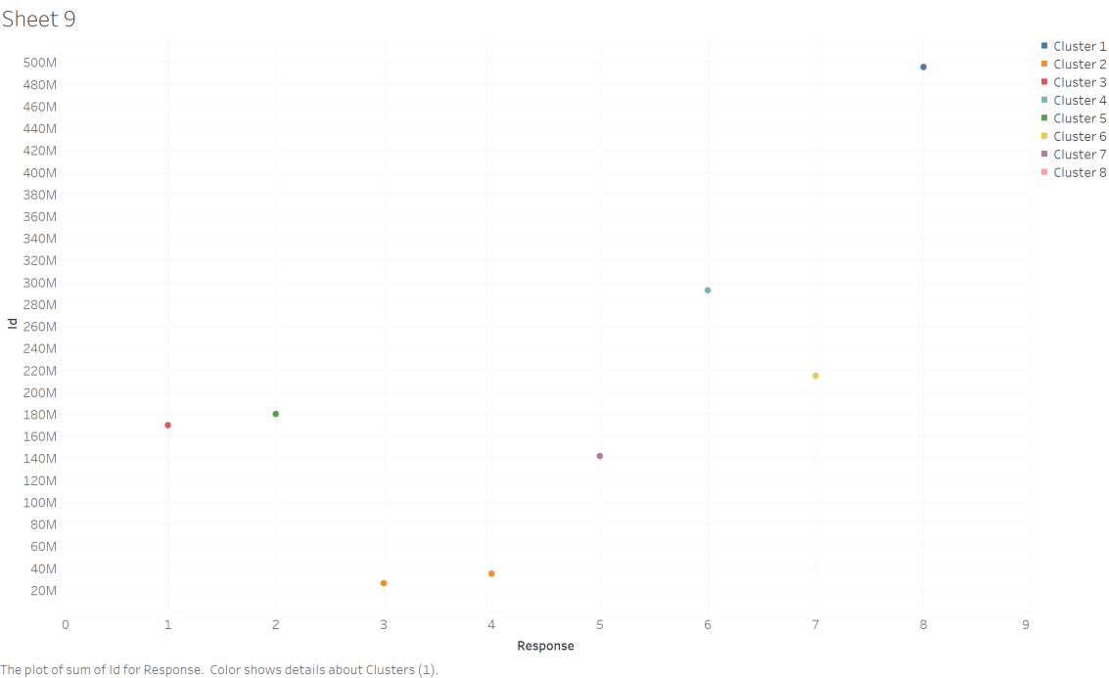
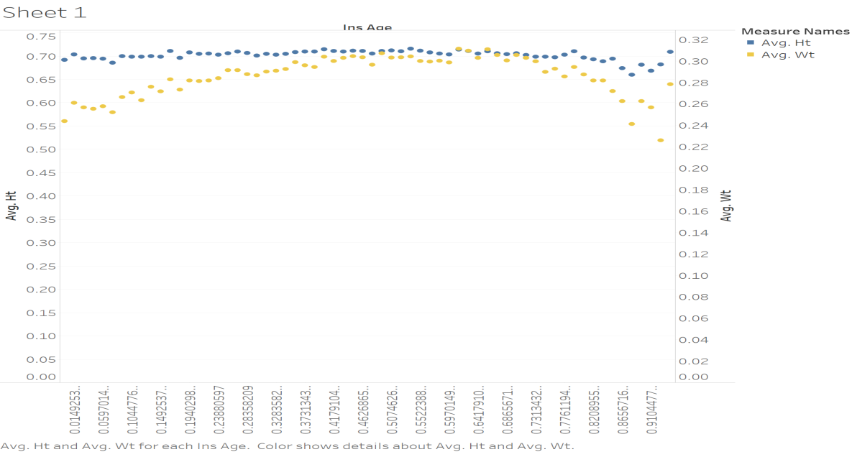
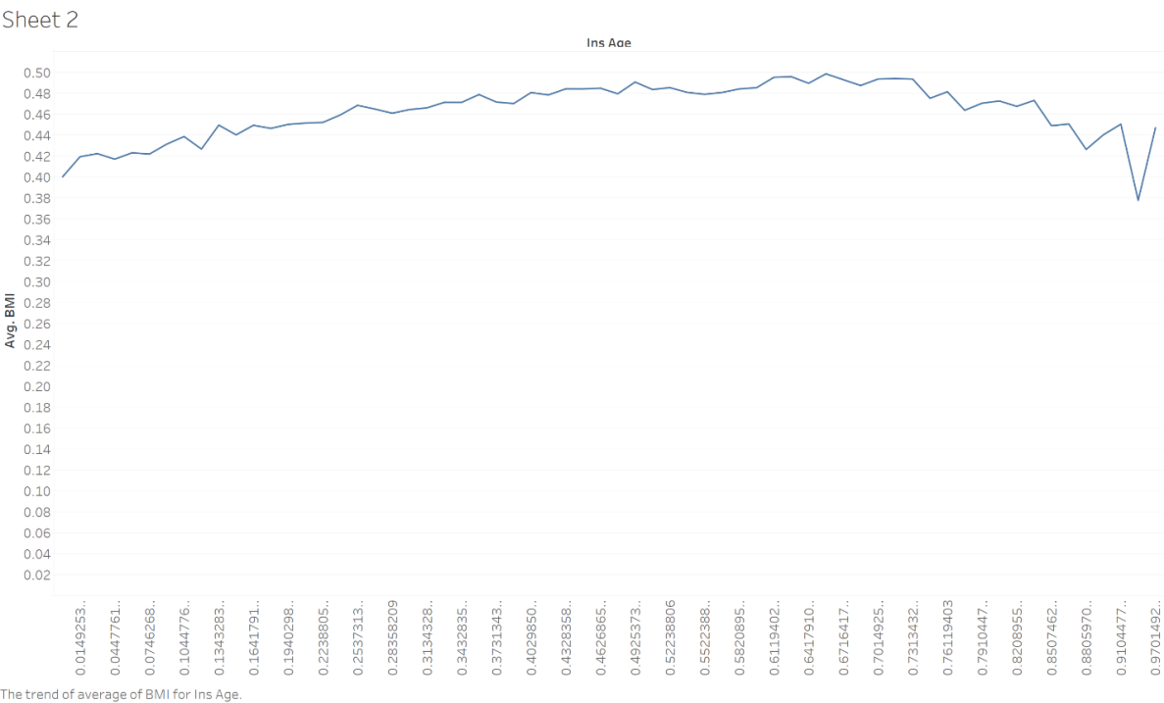
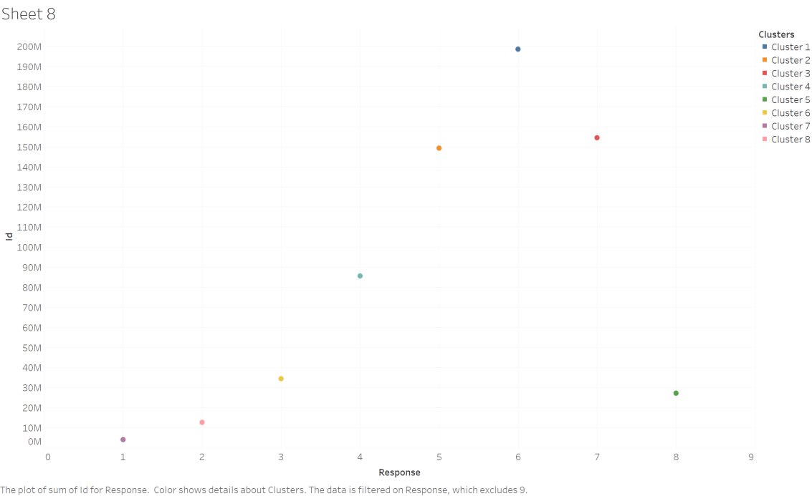
Data Visualization using Tableau

Slide 7
Multiple Linear Regression: Introduction & Steps
The multiple linear regression is used to explain the relationship between one continuous dependent variable from two or more independent variables.
Steps involved during building the multiple linear regression were:
Splitting the dataset into test(40%) dataset and train(60%) dataset.
Generating the first linear regression model with all the 127 independent variables using Backward elimination
After building the model many variables had singularity (similarity) with other variables leading to their elimination
Again the model was build this time with fewer number of columns and R-squared, adjusted R-squared were checked
This time the variables (columns) having less or no significance in the model on observing their significant codes were eliminated
The final linear regression model was selected after the R-squared and adjusted R-squared values started to decrease after eliminating more columns that were later restored
The final model was used to predict the Response variable for the test dataset predicting values anywhere between 1 to 8
The predicted output and the actual output was then used to get the mean squared error by applying MSE formula
Notes:
Lesson descriptions should be brief.

Slide 8
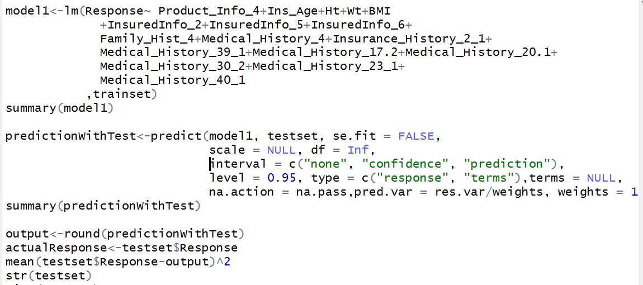
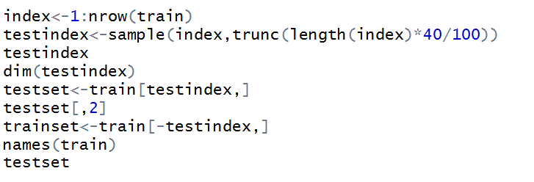
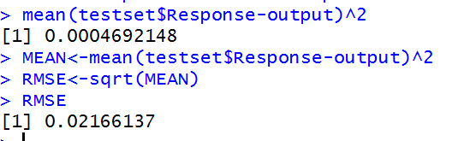

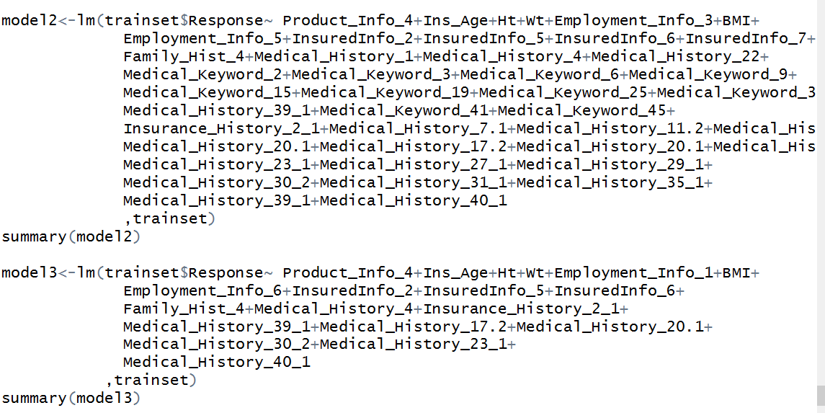
Multiple Linear Regression: Code & Summary
Code Snippet
Data split:
First Model:
First model summary:
Residual standard error: 1.992 on 30049 degrees of freedom
Multiple R-squared: 0.3583
Adjusted R-squared: 0.3553
F-statistic: 117.3 on 143 and 30049 DF
p-value: < 2.2e-16
Notes:
Example objectives
At the end of this lesson, you will be able to:
Save files to the team Web server.
Move files to different locations on the team Web server.
Share files on the team Web server.

Slide 9
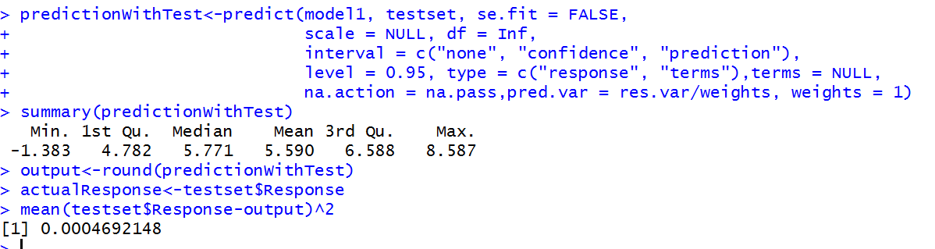
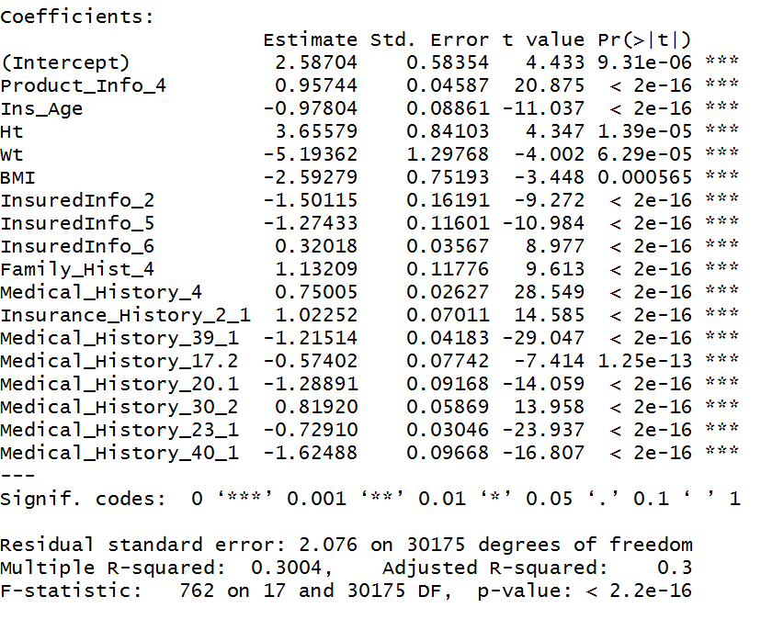
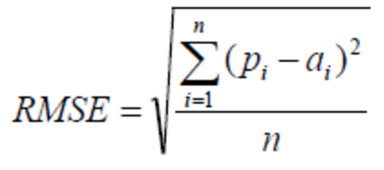
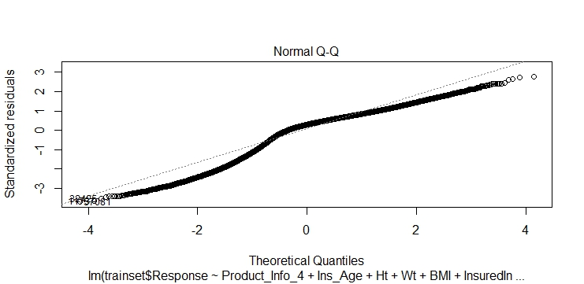
Multiple Linear Regression: Summary
Final Model

Slide 10
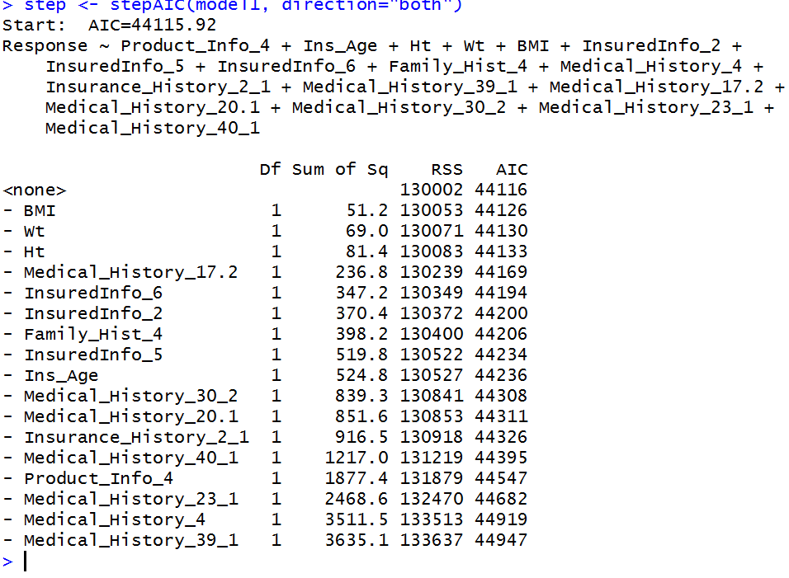
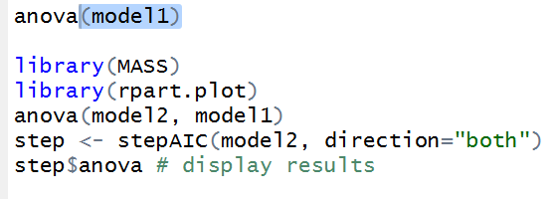
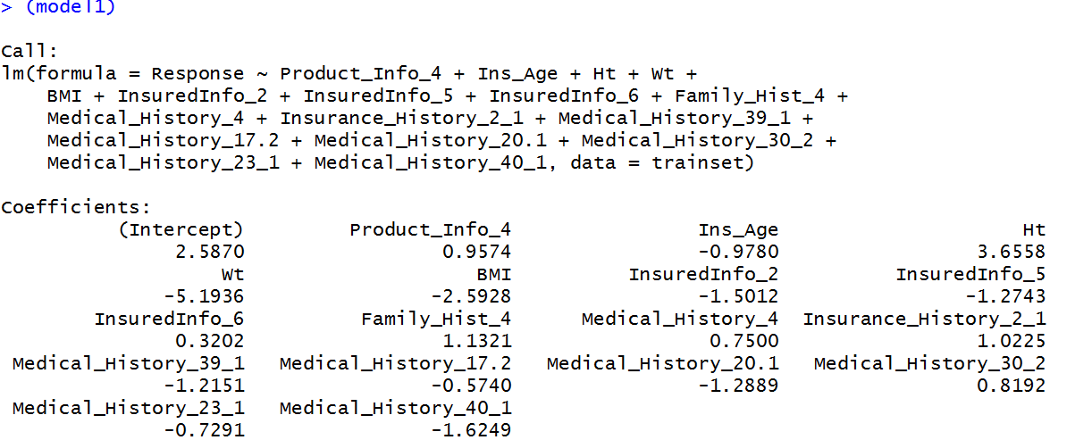
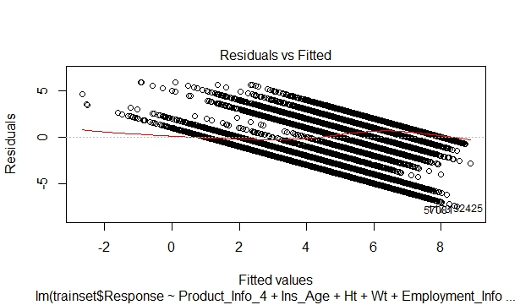
Multiple Linear Regression: Summary
Performance Testing

Slide 11
SVM Regression: Introduction & Steps
The support vector machine is a training algorithm for learning classification and regression rules from data. SVMs are based on the structural risk minimization principle.
Steps involved during building the SVM regression were:
Removing the non numeric and NA columns.
Dimension reduction using the multiple linear regression model.
Sampling the train dataset by splitting it into 80% train data and 20% test data.
Building the SVM model using the train data and checking the predicted data accuracy using confusion matrix.
Tuning the built model by passing a range of cost and gamma values.
After tuning, rebuilding the SVM model using tuned best cost and gamma value.
Predicting the 20% test data using the build SVM model and generated the confusion matrix.
Evaluate the model accuracy using the ConfusionMatrix function of caret package.
Notes:
Lesson descriptions should be brief.

Slide 12
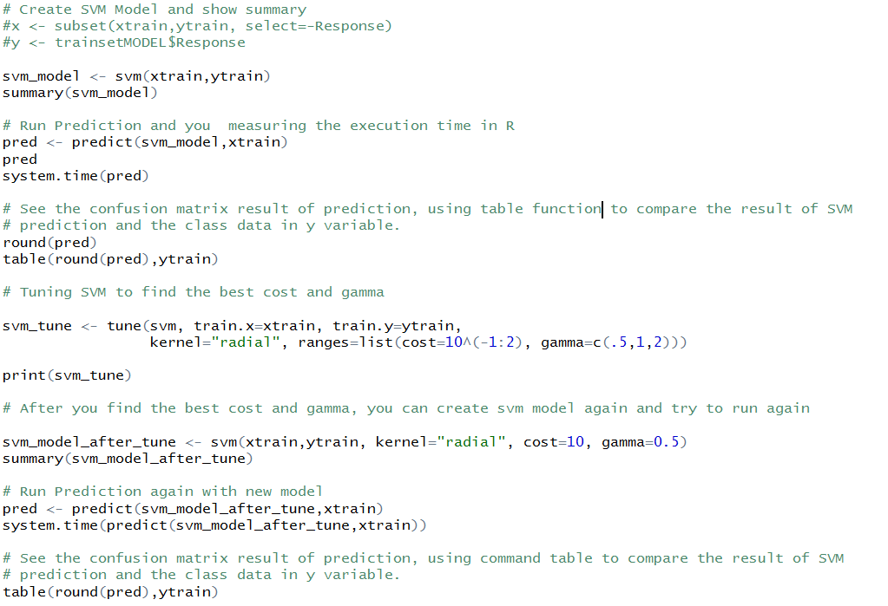
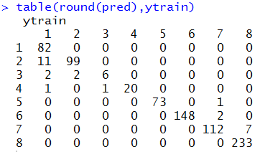

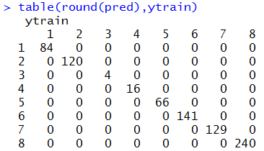
SVM Regression: Code & Summary
Code Snippet:
Before tuning Model:
RMSE Value:
After tuning Model:

Slide 13
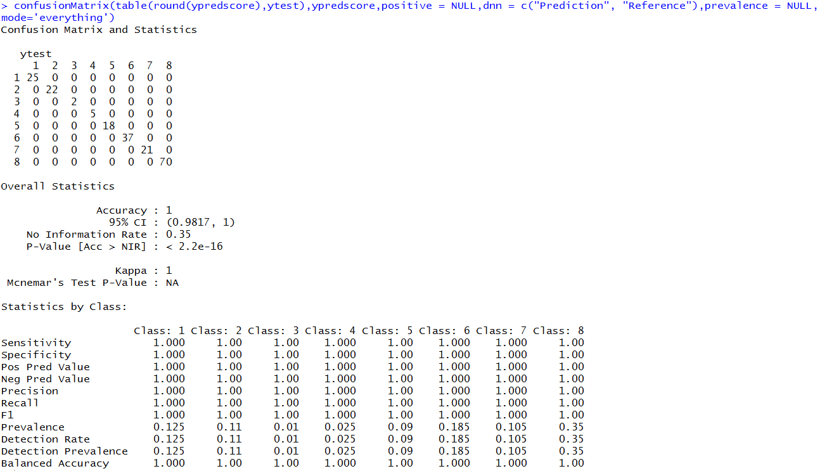
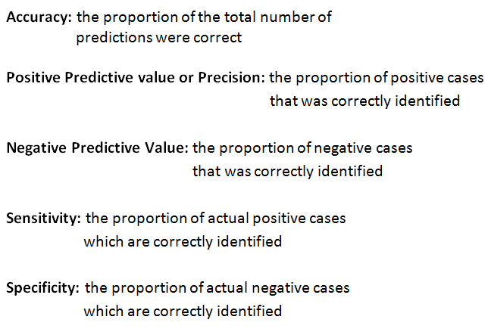
SVM Regression: Evaluation
Compute Accuracy:
Statistics:

Slide 14
Decision Tree Regression: Introduction & Steps
The decision tree regression is used to map observations about an item to reach at conclusions about the item’s target value.
Steps involved during building the decision tree regression were:
Splitting the dataset into test(10%) dataset and train(90%) dataset.
By using the model with a minimum error values the response values where predicted for the actual test data.
Using rpart function created a decision tree model with method anova from traindata .
Using the predict function with the newly created model as the parameter the response for the testdata set was predicted.
Using accuracy function with the predicted result and actual response as parameters ME ,RMSE ,MAE ,MPE,MAPE values where calculated
Notes:
Lesson descriptions should be brief.

Slide 15
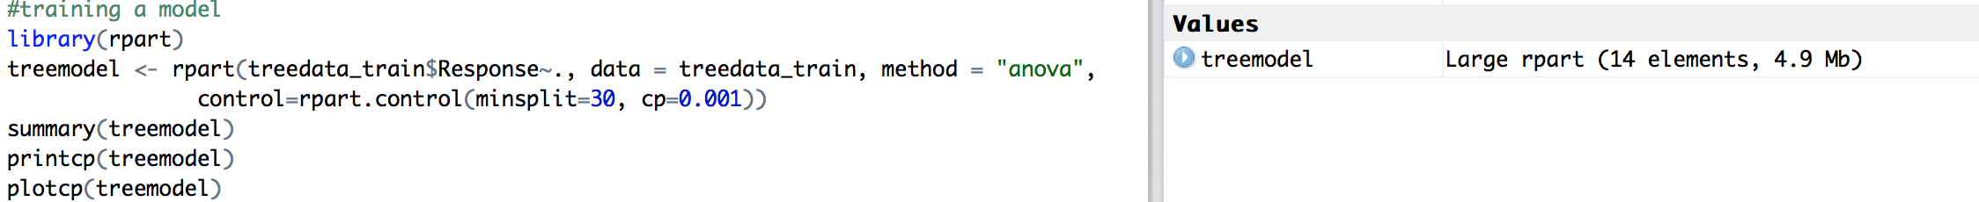
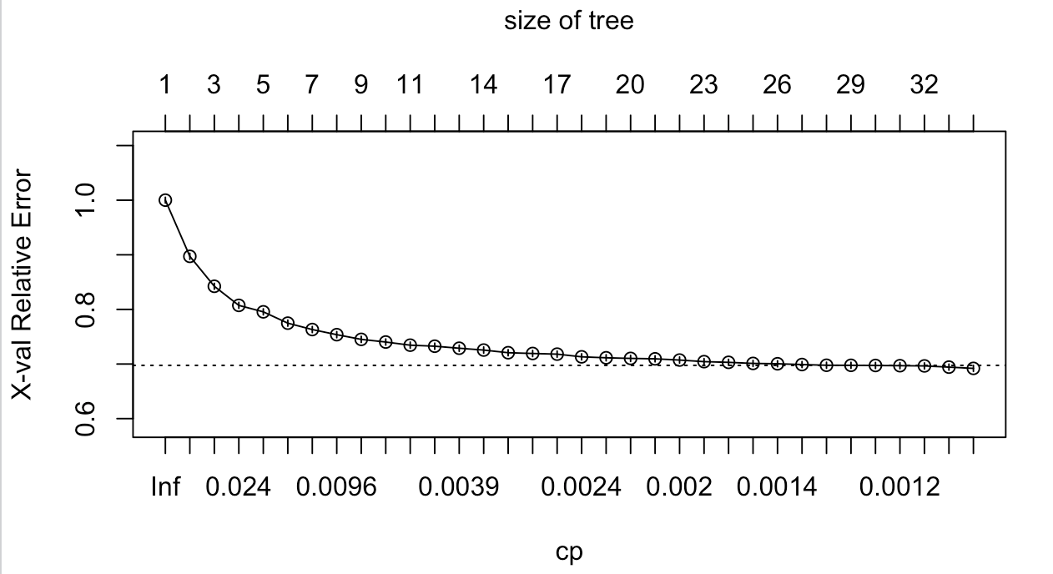
Decision Tree Regression: Code & Summary
Code Snippet
Data split:
Training model:
Notes:
Example objectives
At the end of this lesson, you will be able to:
Save files to the team Web server.
Move files to different locations on the team Web server.
Share files on the team Web server.

Slide 16
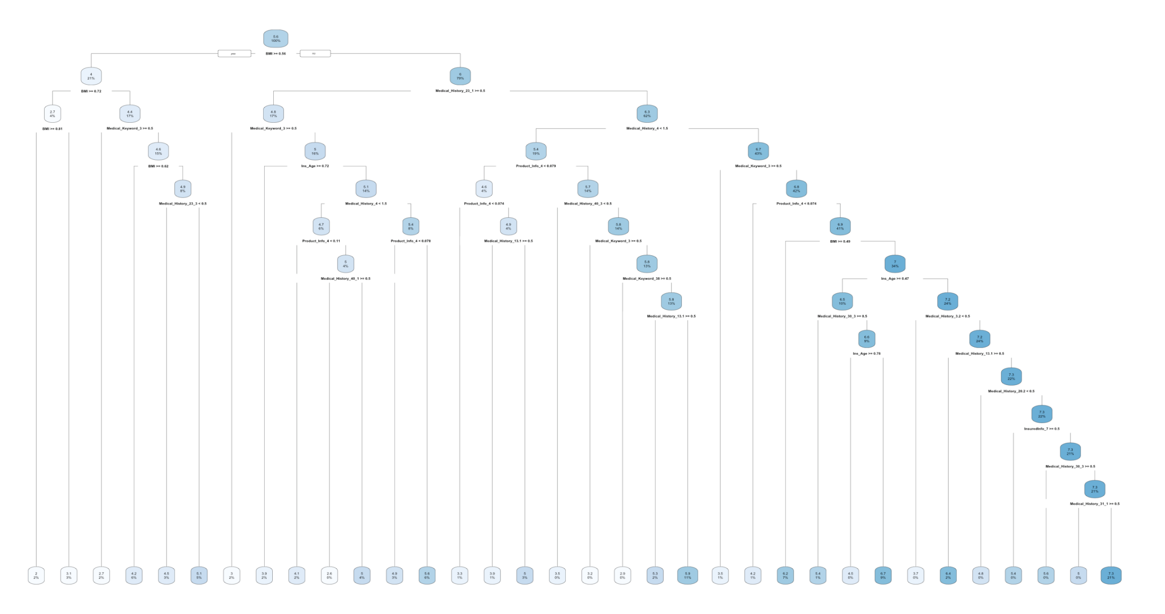
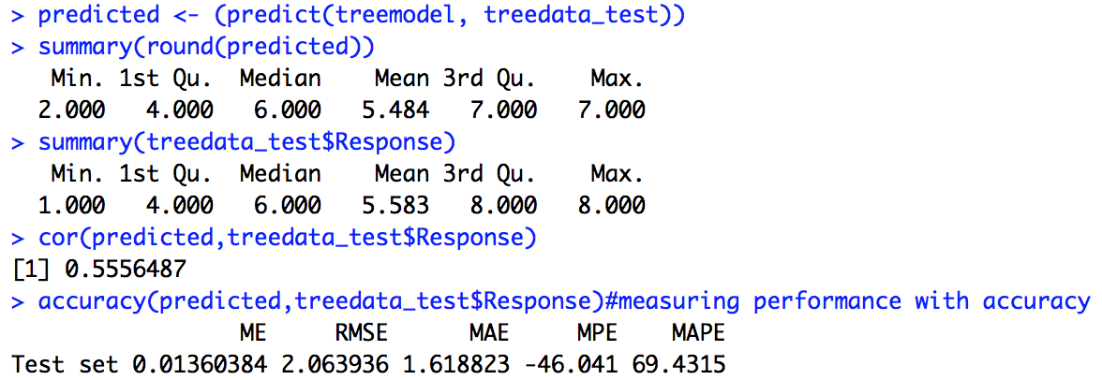
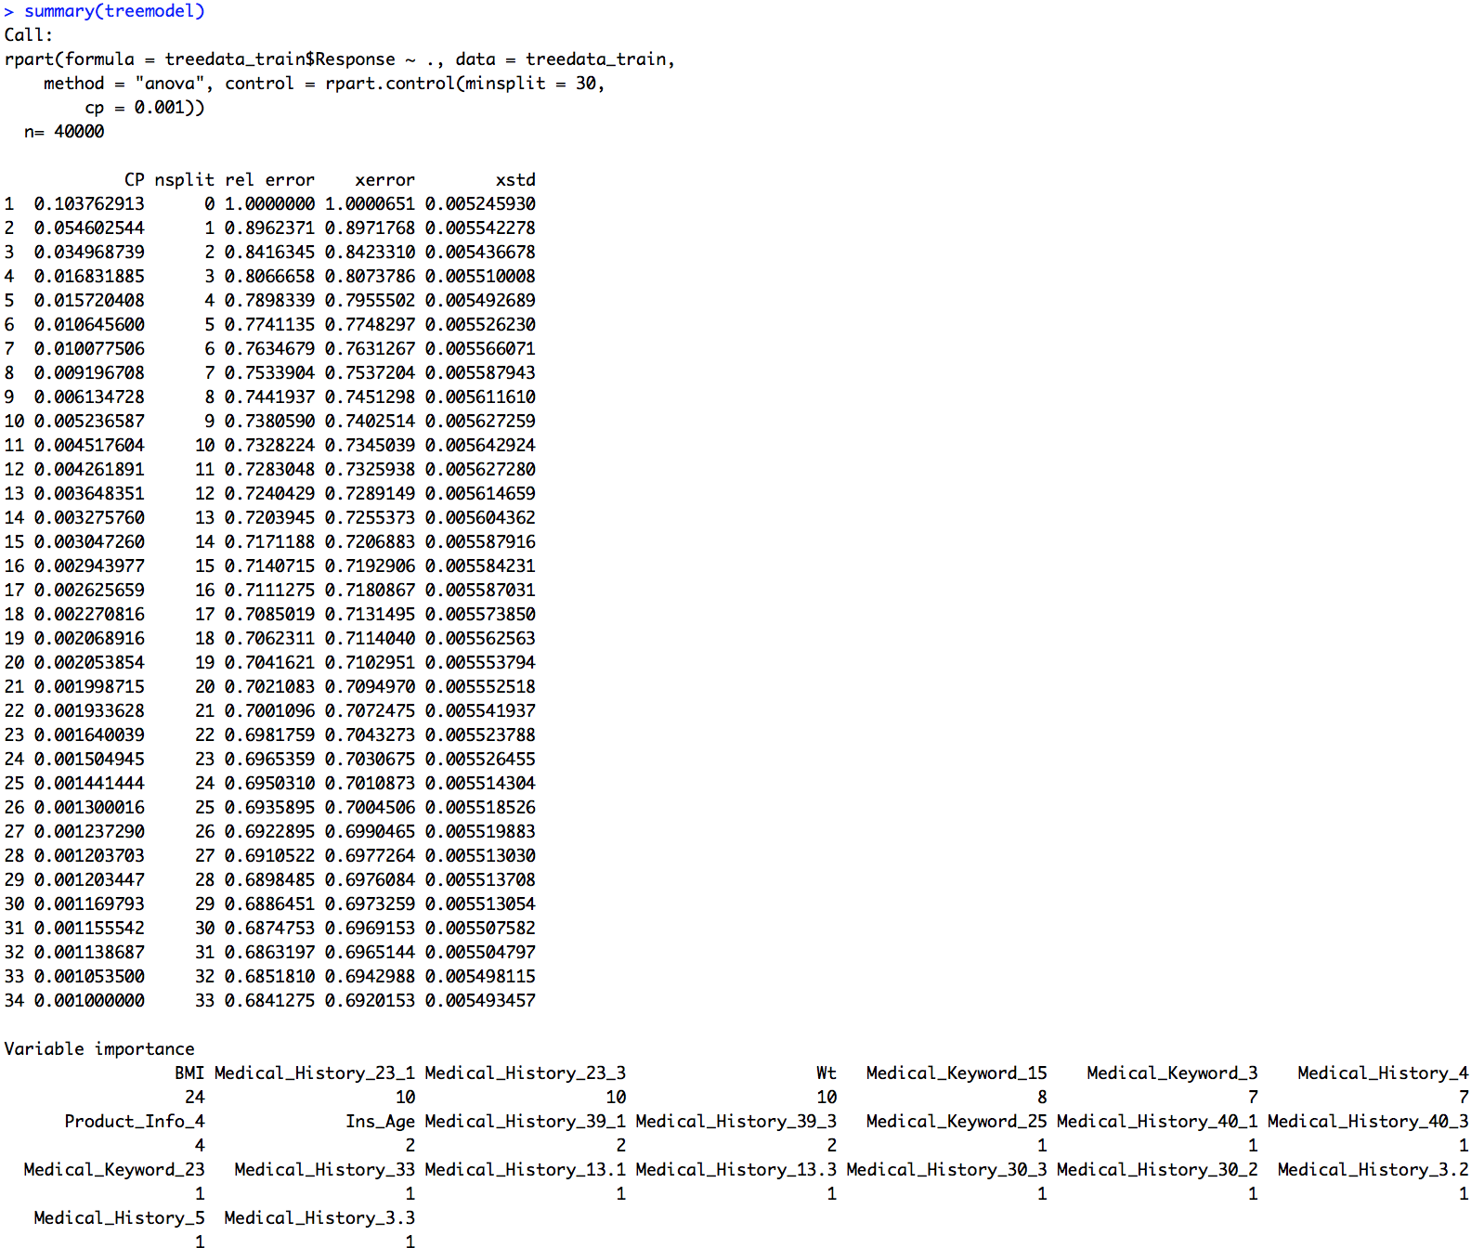
Decision Tree Regression: Summary
Model Summary

Slide 17
Data Story
Previously the data had many missing and noise. By preprocessing the data all the noise and outliers are removed.
After applying the three models on preprocessed data, we predicted the level of risk and eligibility for applicants.
Three different results has been obtained, based on which the error, performance and accuracy level is computed
Comparing the three accuracy levels the root mean square error(RMSE) of linear regression is the lowest(0.0216). In SVM the accuracy level obtained from RMSE is 0.058. And in decision tree the RMSE value is 2.02. Hence linear regression is best model to predict Prudential life insurance dataset.

Slide 18
Thank You!

